Slide 1
Cudnn based Logestic Model

Slide 2
Code structure
LogisticModel
--Implementation of Logestic Regression Model
LoadCSV
--Load data from iris dataset for LogesticModel to train/predict.
Splitting the dataset to 80% for training and 20% for testing.
Train the model by using BP.
Predict and evaluation.

Slide 3
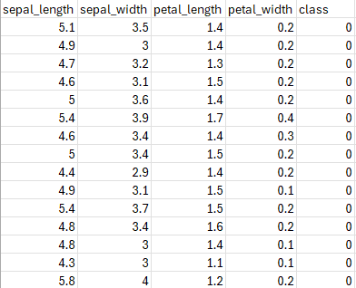
Dataset
Using iris_preprocessed dataset.
Using a Python script to load the dataset from url and saved as csv format file.

Slide 4
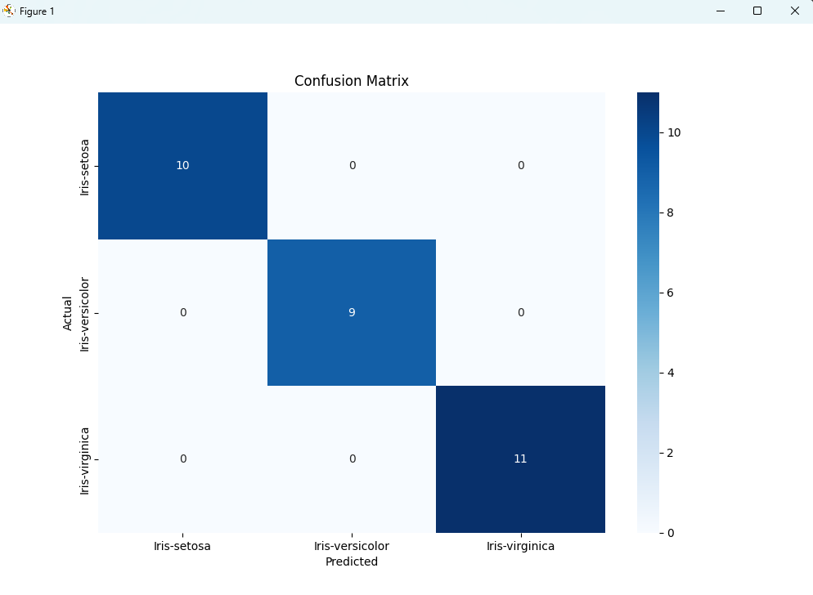
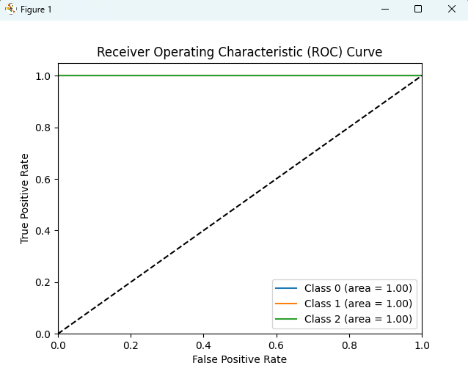
Resluts&Evaluation

Slide 5
Thanks

